Slide 1
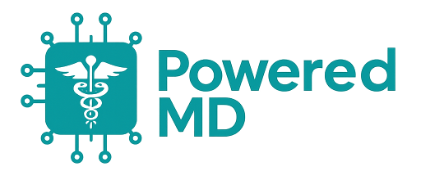


The Future of Electronic Health, Powered by AI
Cover
FROM E-HEALTH TO AI-HEALTH
The Future of Electronic Health, Powered by AI
Eliminate the Electronic Health Record (EHR) burden by leveraging Generative AI to automate 90% of the administrative work (scheduling, content generation, data entry, and report writing)
Traditional EHR systems overhead contributing to stress and burnout
Physicians only need to provide minimal input, such as “Yes”, “No”, or correcting minor mistakes
Cut down management time by 10X, reducing what was previously 1 hour of overhead to just 5 minutes
Emerging global EH market, with increasing demand for automation and AI-driven healthcare solutions
By addressing critical inefficiencies in current systems, our product is positioned to disrupt the EH market
Core team of physicians, AI experts, business experts, holding MD, PhD, and MBA degrees

Slide 2


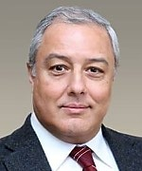

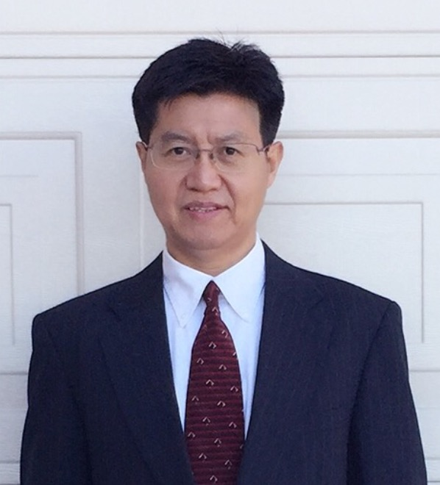

Empowering Physicians with AI
Team
TEAM
Sunny Liu
MS, MBA
Department of Health, State of California, 17 Years Healthcare Cyber Security. 7 years in Cisco. Managing $billion projects
Lotfi Hacein-Bey MD
Professor, Department of Radiology, Stanford Univ.
Program Director, UC Davis, Neuroradiology Fellowship, Associate Chair of Neuroscience Research
Guohua Xia
MD, PhD
Board Certified Psychiatrist, Researcher and Psychologist, NARSAD Young Investigator Award, First to bring TMS
Jonathan Yue
PhD
Expert in AI, and Medical Image Processing. Publication on IEEE Trans. Med. Imaging, Marquis Who's Who honoree
Nick Bell
Director Sales
Ushur Inc. Built and scaled outbound strategy, onboarding, and enablement programs, helping grow company revenue from $50M to $250M

Slide 3



Empowering Physicians with AI
Problem
PROBLEM
Physicians complain 3X overhead in traditional EHR, workload beyond regular work hours, stress and burnout, complex usability, information overload, managing influx of messages as second set of patients.
  Buyers of PoweredMD: Healthcare providers and other participants (Radiologists, Cardiologists, Psychiatrists, Pediatricians, Testing labs, Dentists, General Practitioners, Dermatologists, Orthopedic Clinics, Gynecologists/Obstetricians, Ophthalmologists, Chiropractors, Endocrinologists, ENT Specialists, Oncology Clinics, Geriatric Clinics, Rehabilitation Centers, Weight Loss and Wellness Clinics, Telemedicine Providers, and Specialized Care Centers)
  Our target customers are frustrated with current EHR because: 1) difficult to use; 2) poorly designed (not by physicians); 3) excessive clicks and fragmented data; 4) repetitive copy of records; 5) even experienced physicians must navigate through complex features (buttons, menus, data entry), consuming valuable time; 6) lacks ability to understand a physician’s intent and provide intelligent guidance for data input and next steps; 7) as a result, users experience dissatisfaction, wasted time, increased frustration and stress, decreased efficiency, and less time on patients.

Slide 4




Empowering Physicians with AI
Solution
SOLUTION
Enabling physicians to interact with the system using natural language, through either audio or text commands. In a typical setup, physicians use a mobile Bluetooth microphone to dictate instructions to the system. Our PoweredMD software, driven by multimodal agentic AI and unique vector database, can accurately understand the physician’s instructions and autonomously perform the required tasks, reducing administrative burden.
Addressing a major unmet need in EHR space by eliminating the cumbersome and inefficient processes that overwhelm healthcare providers. Traditional EHR systems require physicians to spend significant time on administrative tasks such as data entry, navigation through complex interfaces, and repetitive actions, leading to burnout, reduced efficiency. Our solution empowers physicians to interact with the system through natural language, significantly reducing the time. By leveraging our cutting-edge AI technology, we enable physicians to complete administrative work quickly and accurately with minimal input.
Benefits: 1) time savings; 2) improved efficiency; 3) enhanced user experience; 4) reduced burnout and stress
Simply talk to the system, and AI takes care of the rest. The AI even reminds physicians about the next steps.

Slide 5

Empowering Physicians with AI
Traction
TRACTION
Customer pipeline: 1) We successfully assisted California Northstate University (CNU) in building a robust computer security network to connect medical devices and offices across three buildings in College of Dental Medicine and College of Medicine, ensuring data protection and compliance with healthcare regulations. Over the next 10 years, the CNU Medical Center will add significantly to the economic output in the region, producing nearly $14 billion; 2) Stanford Medicine, NuroRadiology Division, customizable and portable advanced neuroimaging techniques including dual-energy CT, functional MRI, spectroscopy, and perfusion imaging; 3) 35 small-size healthcare providers.
Acquire/retain customers: 1) Demonstrating Time and Cost Benefits; 2) Successful Case Studies and Testimonials; 3) Partnerships and Networks; 4) Continuous Improvements and Quick Turn Around (customer-centric, agile, quick delivery from feedback)
Proof customers love/pay for our solution: Radiologist at UC Davis radiologists, after seeing a demo, expressed enthusiastic interest and were highly impressed by our PoweredMD products, demonstrating a deep appreciation for its capabilities. Former Google CEO Eric Schmidt says that given how AI can understand natural languages like English, users will simply be able to ask their computers what they want. “I think user interfaces are largely gonna go away. The agents speak English. You can talk to them. You can say what you want”.
Customer Acquisition Cost (CAC) ratio: $80K/10=$8K
Customer Lifetime Value (LTV): average 20 Years@120K, LTV $2400K, LTV:CAC=$2400K:$8K = 300:1
Number of downloads / unique new active users: Our JaguarDB vector database supported 3,800,000 million users in health survey
User Retention rates and Churn Rate: expected retention rate 95%
NPS Scores: 100
Growth strategy: 1) Product Innovation and Quick turn around new product features based on customer feedback (enhance AI, customize, integrate); 2) Targeted marketing; 3) Retention; 4) Alliances; 5) Global Growth; 6) KPI; 7) Scalability; 8) Funding
Projected growth rate: annual 600%
Data and evidence of the growth rate: AI Health to reach around USD 613.81 billion by 2034, impressive CAGR of 36.83% from 2025 to 2034.

Slide 6



Empowering Physicians with AI
Business Model
BUSINESS MODEL
How will we make money
1) Subscription, Licensing, and Services: Tiered plans for various providers;
2) PoweredMD products and services: AIH (AI Health), AIM (AI Medical Imaging), AIV (AI Video Analysis)
Our unit economics: subscriptions, licensing, and services per customer purchase.
Our cost structure – fixed cost: $4K, Variable cost: $8K; RRP: $120K
Our profit margins
Gross Profit Margin = (Net Sales – cost of services sold) / Net Sales x 100 = 88%
Operating Profit Margin = Operating Income / Net Sales x 100 = 5% (first year)
Net Profit Margin = Net Income / Revenue x 100 (net income=revenue-all expenses) = 68%
Sustainable growth We invest in healthcare technologies and implement fair labor practices to pursue sustainable growth. This balance economic progress with healthy well-being to ensure prosperous future for all. This enhances our company's reputation, attract customers and investors who value sustainable healthcare.

Slide 7







Empowering Physicians with AI
Market
MARKET OPPORTUNITY
Top-down: The global Total Addressable Market (TAM) for healthcare software (EHA and AI medical imaging) is an emerging landscape, fueled by increasing AI technology adoption, the demand for efficient solutions, and the ongoing digital transformation within the healthcare sector. Based on various market research reports, the global healthcare software market is projected to USD 180 billion by 2030 with a CAGR of 35.0% Serviceable addressable market (SAM): USD 45 billion.
Bottoms-up: Small-size customers 5442 (annual $20K), medium-size customers 3265 (annual $120K), large-size customers 2177 (annual $1M), to reach $45 billion SAM by 2030.
Growing demand for remote healthcare services (telemedicine): The pandemic accelerated the adoption of virtual care, and it continues to be a key driver.
Advancements in AI and data analytics: AI-powered solutions enhance diagnostics, personalize treatment, and improve operational efficiency.
Focus on healthcare provider and patient engagement: Patient portals and engagement tools are becoming increasingly important for improving patient satisfaction and health outcomes.
Emphasis on data security and interoperability: Compliance with regulations like HIPAA and the need for seamless data exchange between different systems are crucial for market success.

Slide 8

Empowering Physicians with AI
Financials
FINANCIALS
Estimates of how much money we will make in the next 3-5 years: USD $500-1000M
Our strategic plan to penetrate the healthcare AI market is exceptionally clear and well-defined, beginning with our immediate readiness to sell and support the Healthcare Jaguar Vector database for California Northstate University, specifically targeting significant service contracts in video storage and analysis to establish an immediate foothold, and then, within a concise timeframe of four to six months, we are poised to expand significantly by selling our AIH solution to 35 small-size clinics, demonstrating a clear path to broader market adoption and scalability before culminating in a major milestone within one year, where we will introduce our advanced AIM solutions to Stanford Medicine, leveraging the substantial and accelerating global demand for AI health solutions to propel our overall growth.
The global market for AI in healthcare is experiencing a truly remarkable growth trajectory, with projections indicating a robust expansion driven by technological advancements and the increasing demand for efficient and personalized healthcare solutions, where for instance, the market was valued at approximately USD 26.69 billion in 2024 and is now anticipated to reach around USD 613.81 billion by 2034, reflecting an impressive compound annual growth rate (CAGR) of approximately 36.83% from 2025 to 2034.

Slide 9

Empowering Physicians with AI
Competition
COMPETITION
Competitors in this space: Epic, Cerner, Athena, and qure.ai
While Epic, Cerner, and Athena offer heath record capabilities, they are often criticized for being cumbersome, difficult to navigate, and non-intuitive. Physicians spend a significant amount of time navigating complex interfaces and entering repetitive data. Our AIH system simplifies the user experience by enabling voice-command interactions, eliminating repetitive data entry and clicks. Physicians only need to speak or type simple commands (e.g., “show today’s appointments,” “schedule a new patient,” “update patient record”), which the system understands and acts upon. This reduces administrative overhead and allows doctors to focus on patient care rather than struggling with a complex interface.
Qure.ai focuses heavily on image analysis and diagnostic assistance. However, it does not address the broader scope of EHR management. We combine multimodal AI, including voice recognition, image processing, and natural language processing, into a single integrated platform. This means healthcare providers can manage patient records, diagnostic imaging, and tasks using voice commands or text-based input. Voice-enabled interfaces are especially valuable for physicians who need a hands-free solution to manage their workflow during patient visits.

Slide 10

Empowering Physicians with AI
Funding
FUNDING STATUS
Seed Stage
Funding Raised: $400K in Year 2016, PoweredMD early 2025
Needed Funding: USD $4-8M Runway 2 years
Deployment of Funds: Customer 3 months; R&D 3-6 months; More customers 12 months
New funding will contribute: 1) support new customers within 3 months; 1) develope new products; 2) expand the team; 3) onboard new customers; 4) accelerate marketing efforts

Slide 11


Empowering Physicians with AI
THANK YOU
SUMMARY
Revolutionary AI-Driven PoweredMD System
Transformative solution from electronic health to AI health
Efficient and effective by disruptive AI technology
Physicians can care more patients with more precise diagnosis and preventive care plan
Better cost-benefits for health providers by reducing manual data entry and more automation
10X improvements on operational efficiency and physician satisfaction
Significant potential for growth, scalability, and market penetration
Unique investment opportunity in the rapidly evolving healthcare technology space
FROM E-HEALTH TO AI-HEALTH
The Future of Electronic Health, Powered by AI
SIMPLY TALK
http://poweredmd.com:5000
Sunny Liu, sunnyliu218@gmail.com (214) 240-6248
Guohua Xia, gxia@brainefit.net (916)450-1446
Jonathan Yue, Jonathan.yue@datajaguar.com (925)577-4418

